Slide 1
Violent Crime Statistics & Correlations
By Casey Campbell

Slide 2
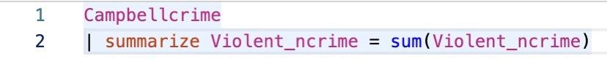


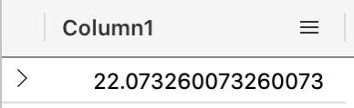
Why is Violent Crime Important?
Total Violent Crimes for PA in 2019:
Average Violent Crime per City in PA:
*Cities are not required to report but over 90% of cities in PA are included

Slide 3
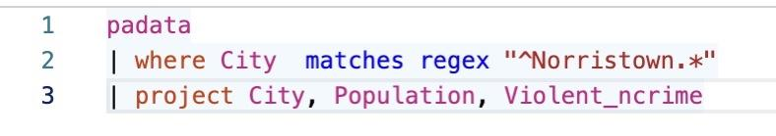

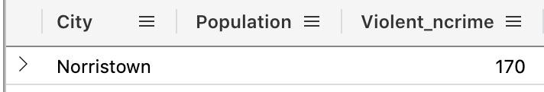
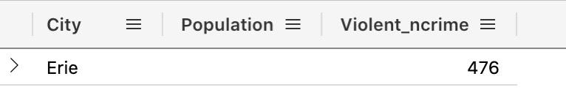
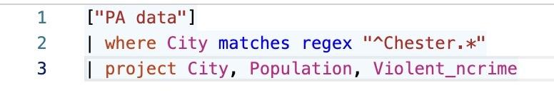

Does the size of the City have a consistent impact on the occurrence of Violent Crime?
Norristown & Chester Population: 30,000 Erie Population: 95,000
From this we gather population does not have a consistent impact.

Slide 4

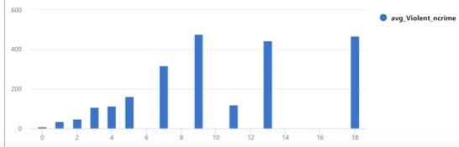
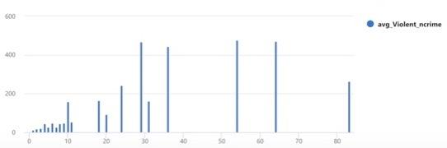
Is there correlation between the specific Violent Crimes and others?
Murder and Nonnegligent Manslaughter & Rape are the best predictors of Violent Crime
Rape is the second best predictor but the last column can be slightly misleading when used for prediction
Murder and Nonnegligent Manslaughter is a slightly better predictor due to slight level of steadiness and increase towards the end of the x-axis

Slide 5
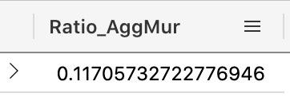
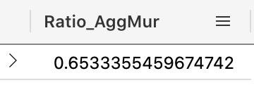
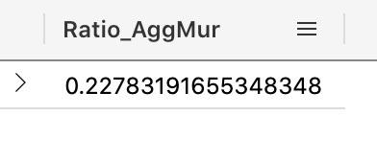
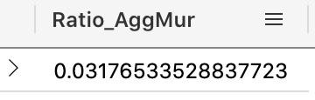
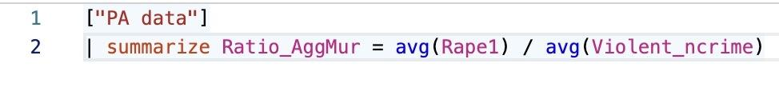
What is the Significance (Percentage) of the Average of Violent Crimes in Pennsylvania?
Rape Aggravated Assault Robbery
Arson
All other crimes such Murder and Nonnegligent Manslaughter, Larceny, Motor Vehicle Theft, etc. were less prevalent than Arson
Formula: (“Rape1” was the independent variable)

